Slide 1
Welcome to HOTT
Health Occupations for Today and Tomorrow

Slide 2
Have you thought much about what you want to be when you grow up?

Slide 3
A Teacher?

Slide 4
An Artist?

Slide 5
Maybe an Athlete?

Slide 6
These are all very important jobs, but did you know there are a LOT of other jobs that help people every day?

Slide 7
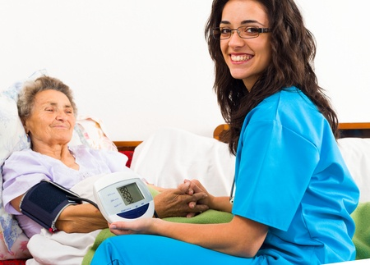
Most of you are familiar with what a doctor and a nurse do, right?
But did you know that there are MANY other jobs in the health field?
Can you name a few?

Slide 8
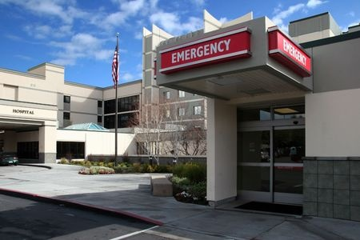
To learn about some of these jobs, let’s go on a virtual field trip and take a tour of a hospital.

Slide 9
Who do you think you will meet first?

Slide 10
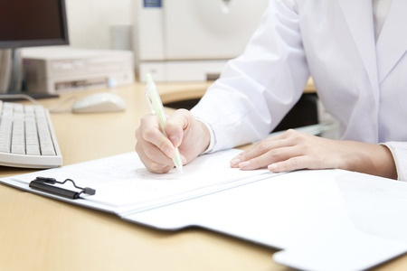
A ________________ or a ________________________________________ will greet you at the door. They help patients with billing, making appointments, and keeping track of medical records.
medical assistant
medical records and health information technician

Slide 11
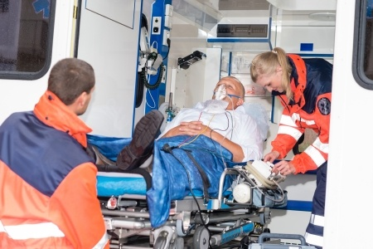
Next, we will walk by the Emergency Department. Here you might see a ________________ bringing a patient into the hospital from the ambulance.
paramedic/EMT

Slide 12
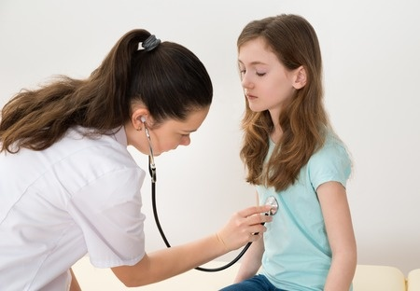
In the emergency room, there is an _________ and a ______ who are trained to handle emergencies.
ER doctor
nurse

Slide 13
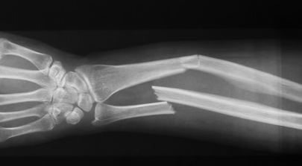
Now, let’s go see the Radiology Department. This is where they take x-rays.

Slide 14
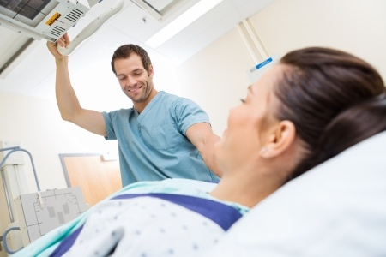
A _______________________ positions the patients and takes their x-rays.
radiological technologist

Slide 15
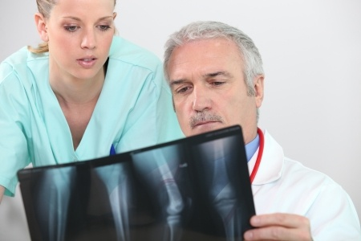
A special doctor called a ____________ examines the X-rays to decide if anything is broken.
radiologist

Slide 16
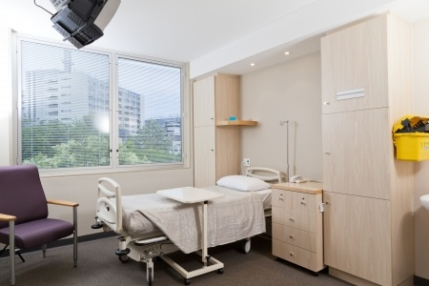
Next, we will see some of the hospital rooms. Some rooms are for mother’s who just had babies, people who are sick, or people recovering from surgery.

Slide 17
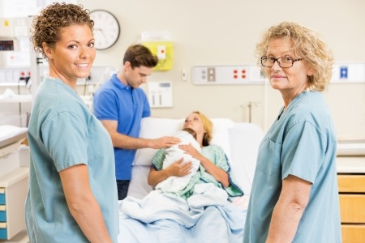
In these hospital rooms, nurses take care of the patients. Nurses can be __________________ or __________________________.
registered nurses (RN)
licensed practical nurses (LPN)

Slide 18
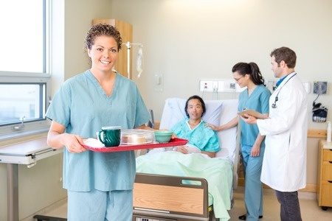
certified nursing assistants (CNA)
There are also ____________________________ who help nurses take care of patients.
They might help feed patients, change sheets and blankets, or move patients to new rooms.

Slide 19
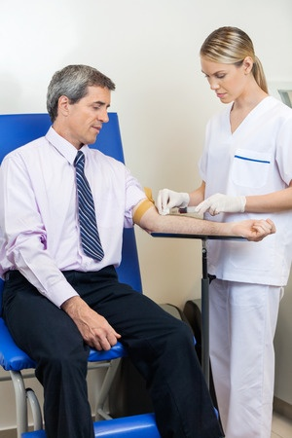
If a patient needs to have tests done, a ____________ draws blood from the patient.
phlebotomist

Slide 20
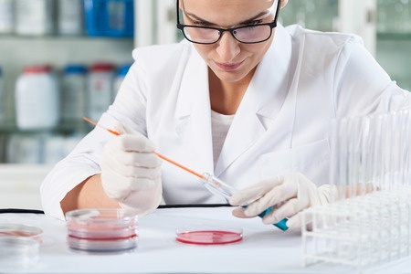
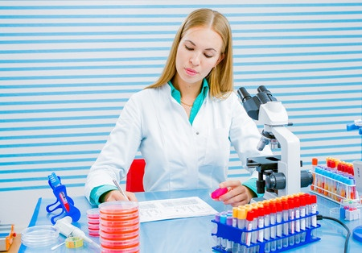
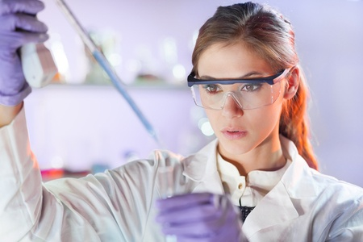
If blood is drawn, the sample is taken to the medical laboratory. This is where the _____________________________ and __________________________ will run tests.
medical laboratory technician
medical laboratory scientist

Slide 21
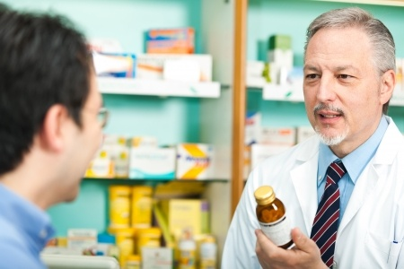
Next, let’s check out the pharmacy. Orders for medicine come to the __________ who works with the ___________________ to prepare and package the medications.
pharmacist
pharmacy technician

Slide 22
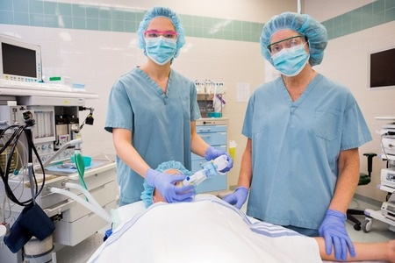
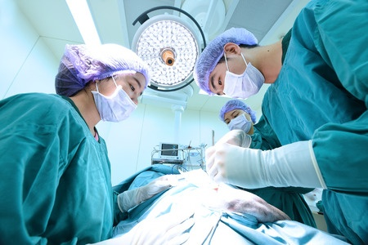
Now, let’s take a look at the Surgery Department where the operating rooms are located. Before surgery, a _______________ gives patients medicine to sleep through the operation. During the surgeries, a surgeon gets help from a __________________.
nurse anesthetist
surgical technologist

Slide 23
Now, let’s head to the hospital kitchen. A _________ works with the cooking staff to make sure the hospital patients get nutritious meals.
dietician

Slide 24
Last stop!
Rehabilitation Department

Slide 25
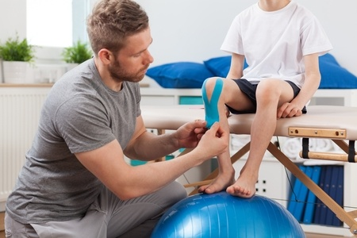
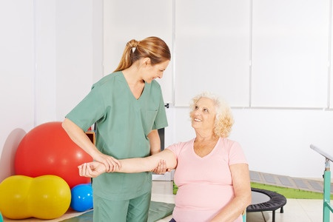
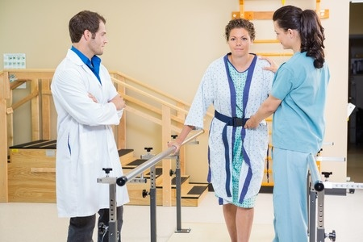
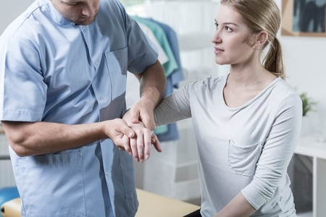
Here there is a large therapy room with exercise equipment and other tools. This is where the ________________ and _____________________ and their assistants work to help patients move better.
physical therapist
occupational therapist

Slide 26
So, next time you think about what you want to be when you grow up…

Slide 27
Remember your hospital tour and ALL of the people who work there!

